Slide 1
Agile Manifesto
BY:- YASHRAJ NIGAM

Slide 2
Prologue
Agile is a methodology primarily used in software development that emphasizes flexibility, collaboration, and customer satisfaction. It was introduced through the Agile Manifesto in 2001, which outlines four core values and twelve principles to guide Agile practices.

Slide 3
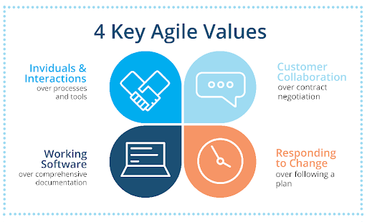
Four Values of Agile Manifesto
Individuals and Interactions
Working Software
Customer Collaboration
Responding to Change

Slide 4
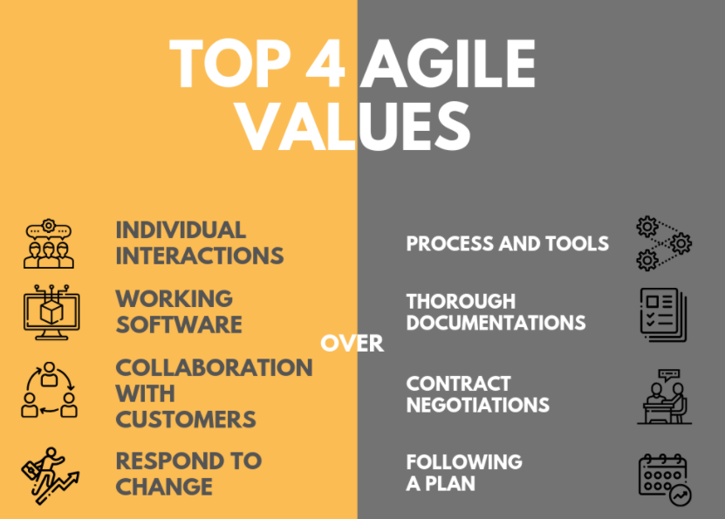
Difference of AGILE over Traditional Methodology

Slide 5
